Slide 1
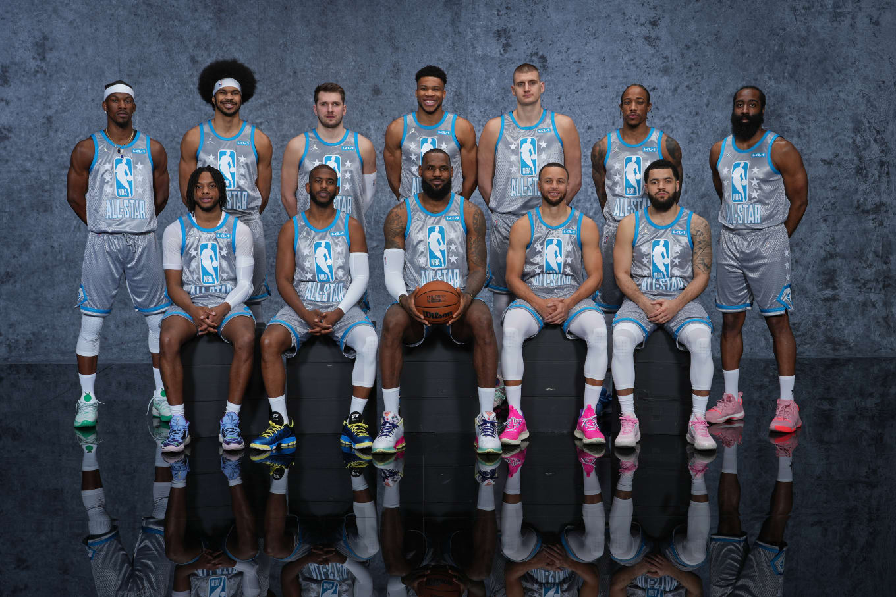
NBA All-Stars
Mehmet Ali Mehmetzade - Kerem Tuna - Sinan Tuna - Sean Park

Slide 2
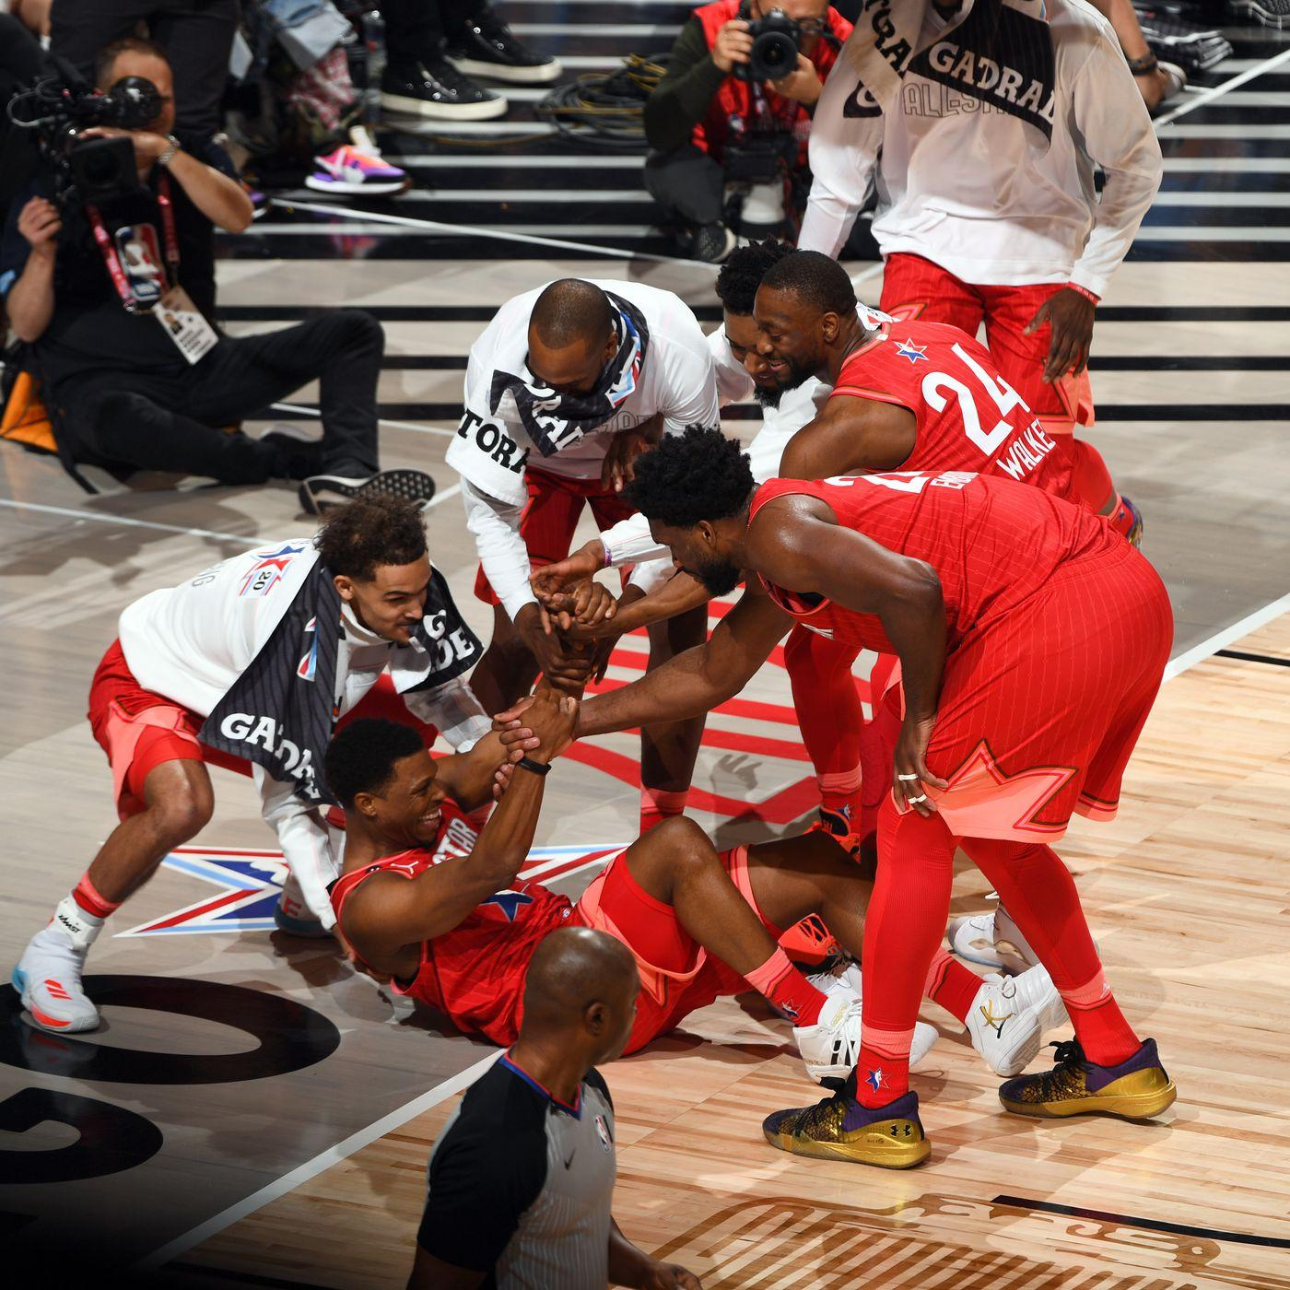
Motivation and Problem statement
The NBA All-Star selections are important for the players, teams, fans and the entire industry.
There are no clear rules for the selection, so we want to understand what factors contribute to the selection
We will try to predict which players make the All-Star team in a given season using their in game statistics.

Slide 3
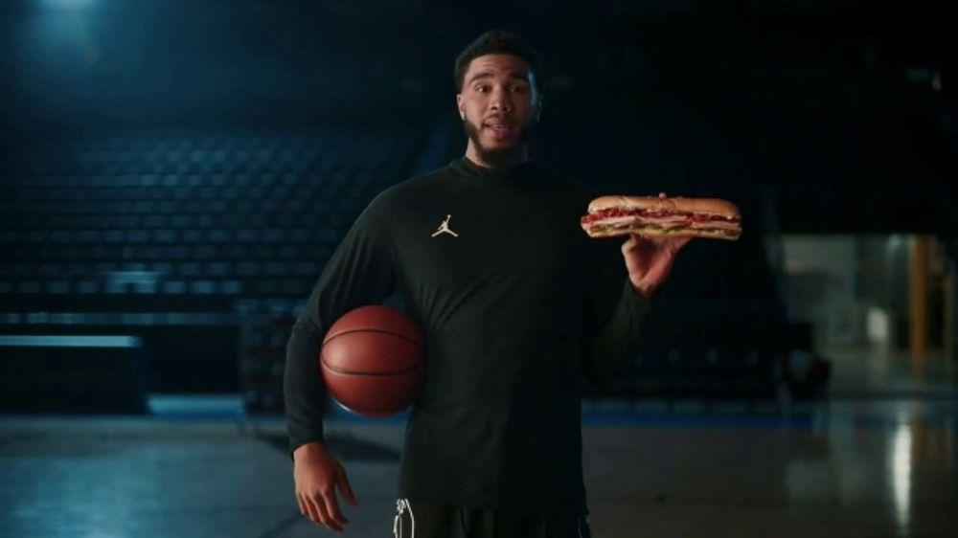
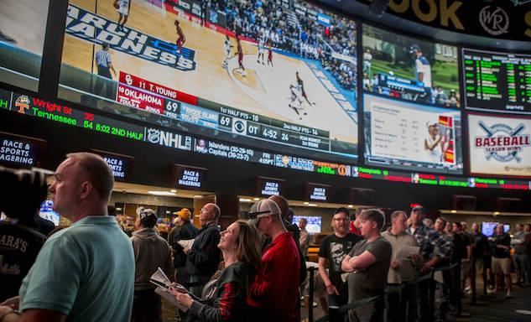

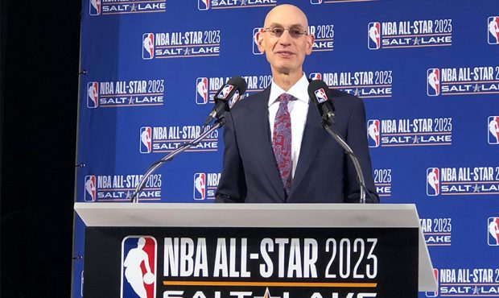
Stakeholders
NBA organization, fans
Sponsors, gaming entities can use it to market their product accordingly
Betting companies can use it to determine odds

Slide 4
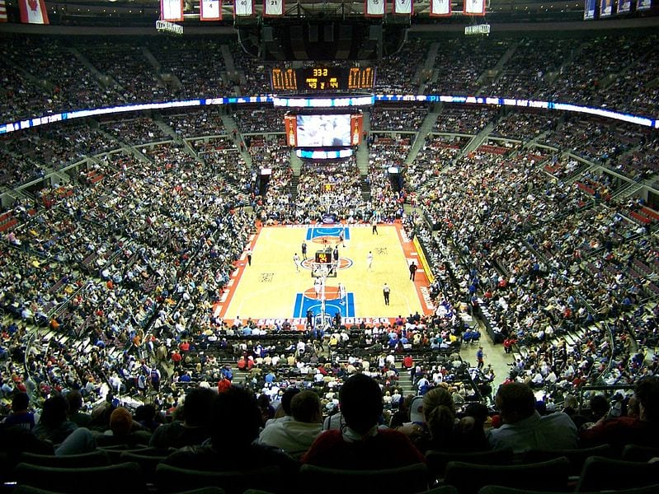
Data Sources
Player Stats & All-Star Rosters
https://www.basketball-reference.com
Data of 15 Seasons
From 2008-2009 season to 2022-2023 season
From 2009 All-Star game to 2023 All-Star game

Slide 5
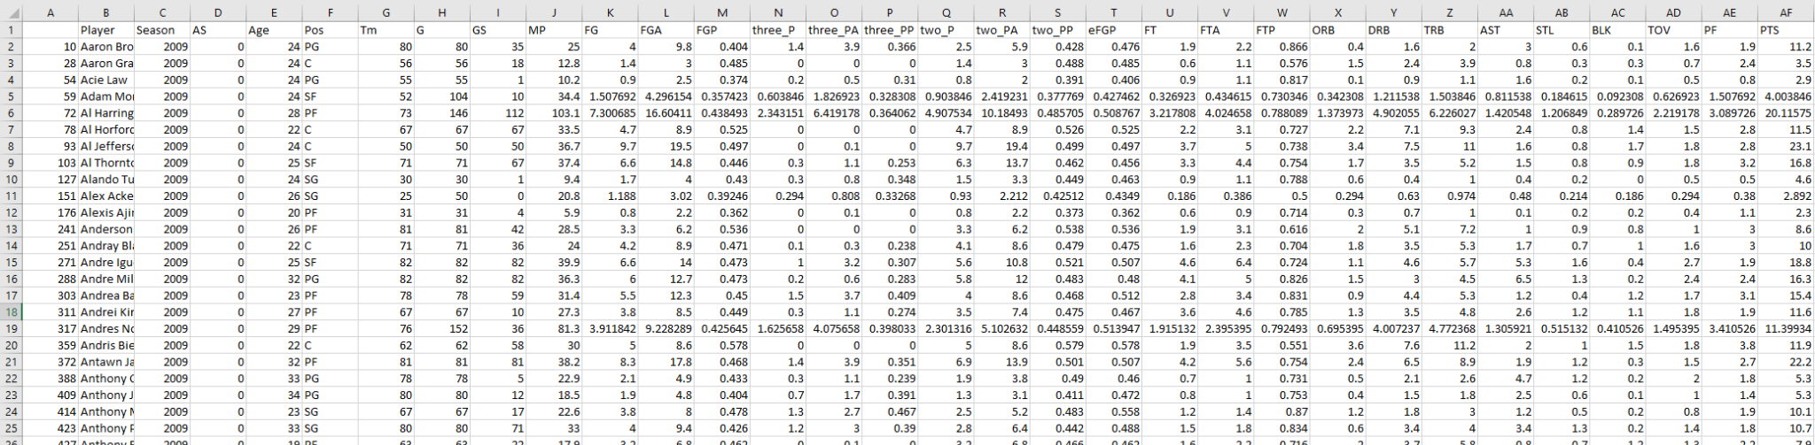
Original Data
Target Column: 1 if all star; 0 else

Slide 6
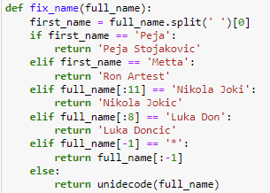

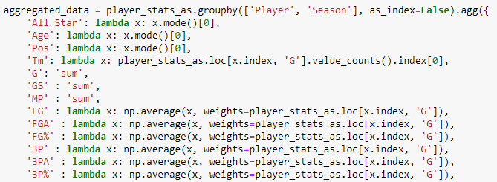
Data Cleanup
Fixing name
For players who used different changed name during career
Names that include non-unicode characters
Merging same player in same season
ex) Player who was traded during the season

Slide 7


Splitting Dataset
15 total Seasons
10 Train & 5 Test
Included (current) 2023 season & Every 3 seasons for testing
Minimize possible yearly trends

Slide 8
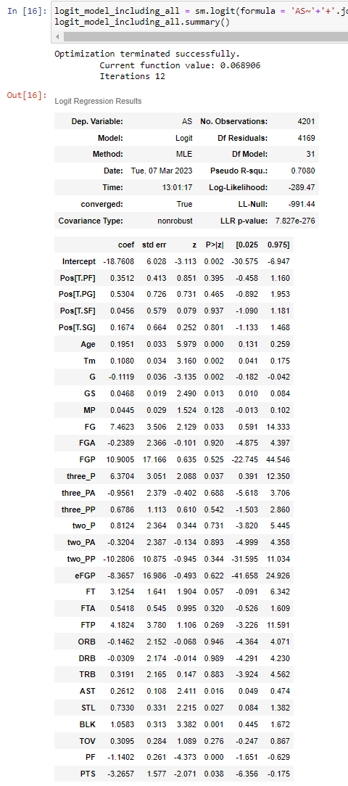
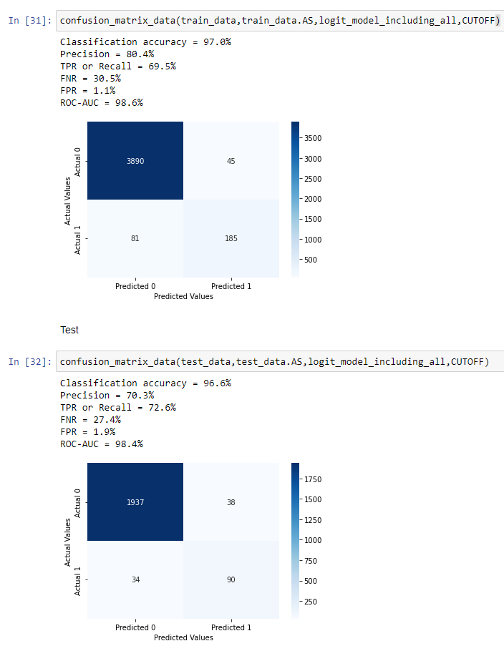
Initial Models
Including all predictors
Our initial idea was to drop the “Season” column and treat the testing data as a whole as if they were all collected from the same time period
Although the model was proven to be accurate, we wanted to lose some of the predictors to reduce the complexity of the model and increase its interpretability

Slide 9
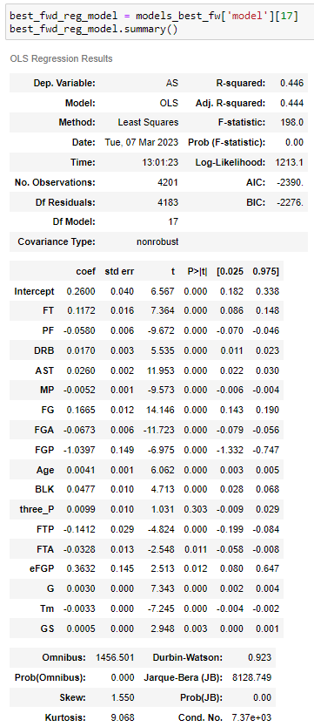
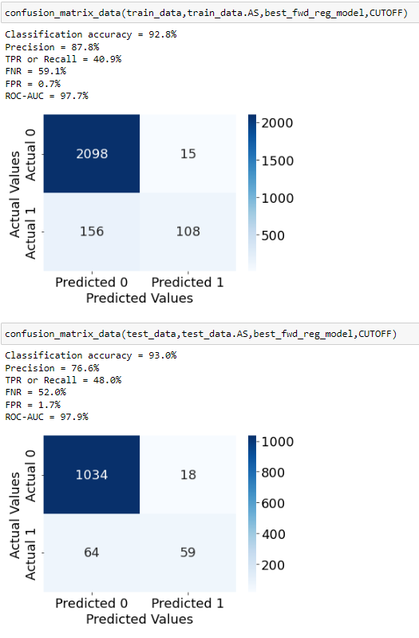
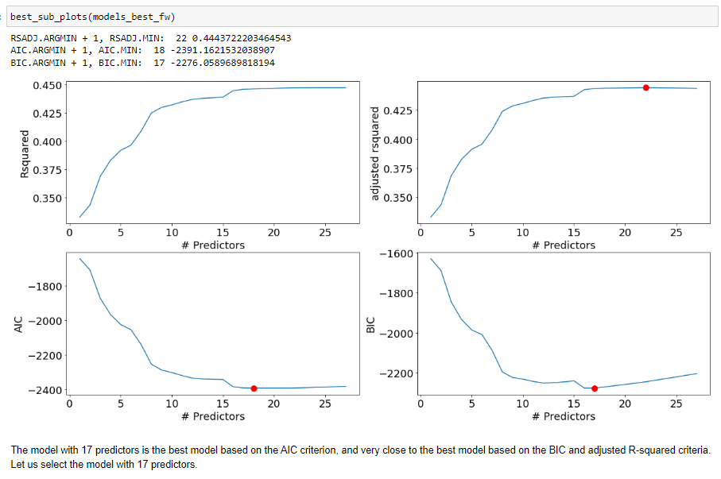
Trying Ways of Reducing Predictors
Variable Selection Methods
Using Forward Selection

Slide 10
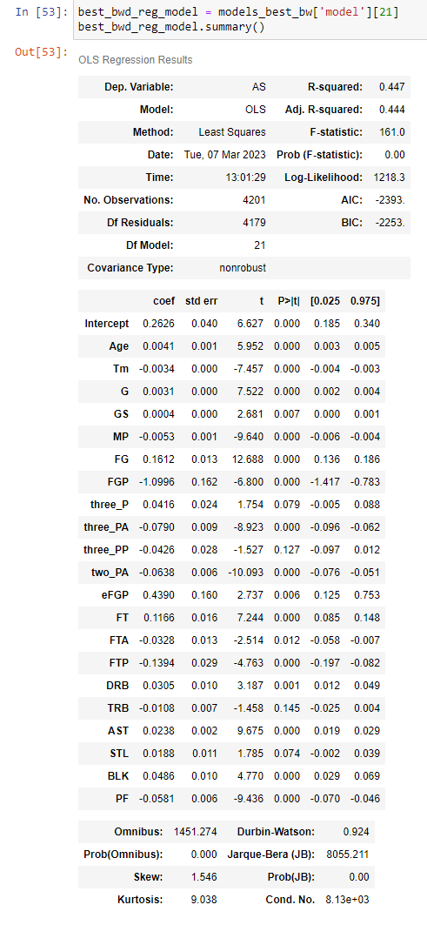
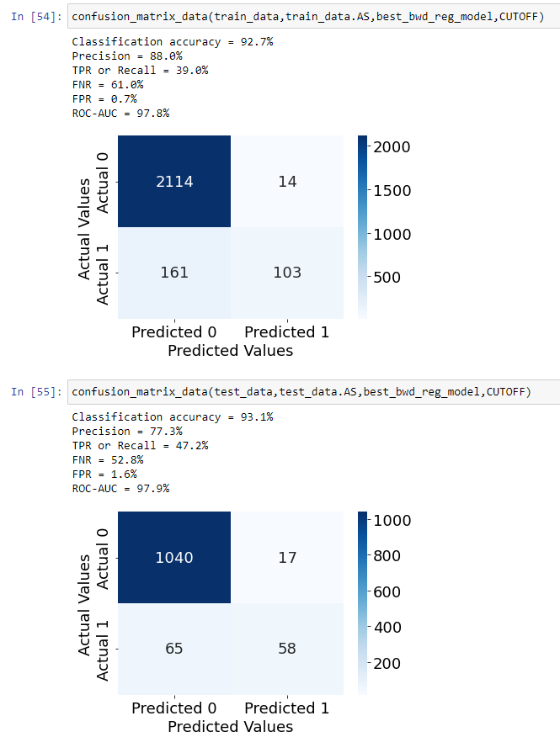
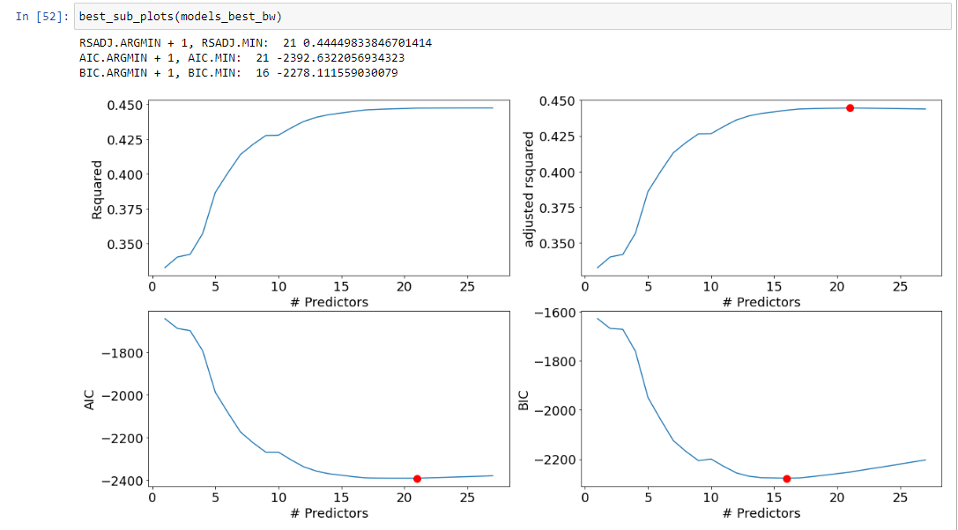
Trying Ways of Reducing Predictors
Variable Selection Methods
Using Backward Selection

Slide 11
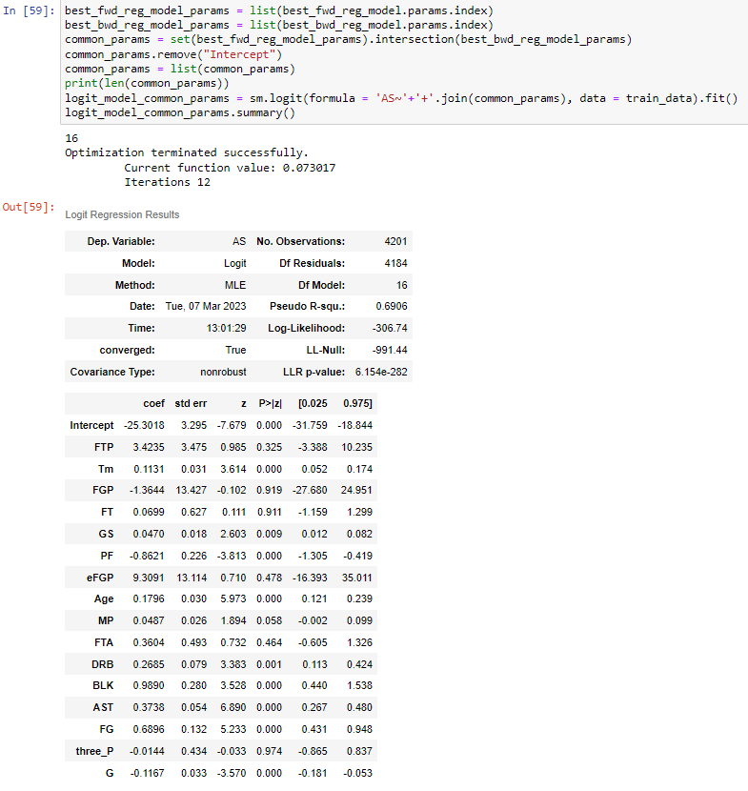
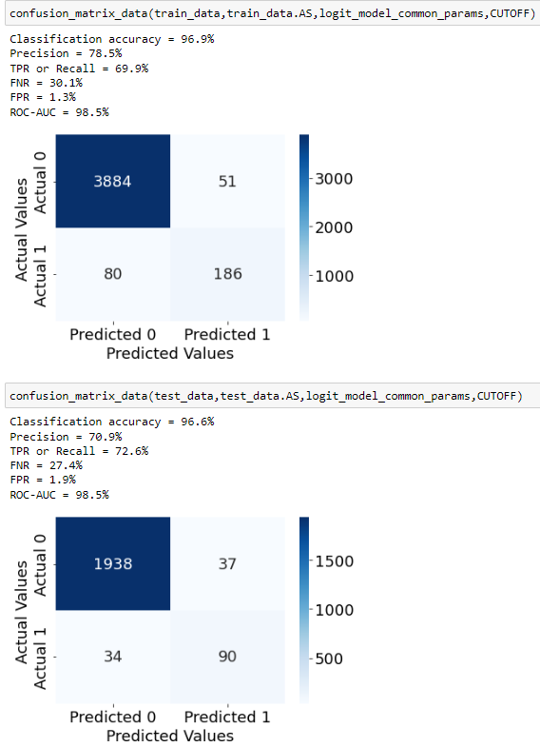
Model Using Common Predictors

Slide 12
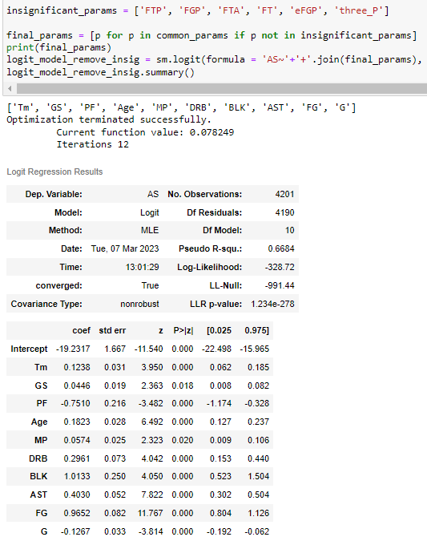
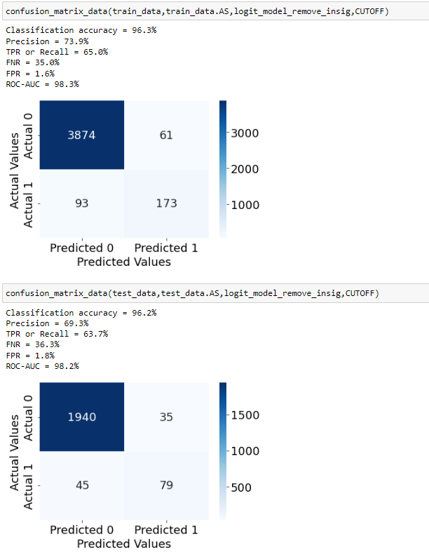
Removing Insignificant Predictors

Slide 13
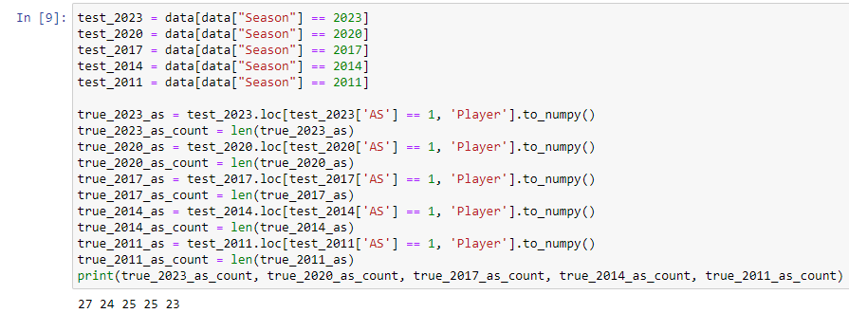
An Alternative Approach
Coming up with the best model
Idea: Every year, there are ≈24 players selected as All-Star
We can choose top ≈24 players for given year and classify them as All-Star
Divide our test data (2023, 2020, … 2011) by year -> 5 test sets

Slide 14
Models to apply
Including all parameters (27)
Remove parameters: correlation > 0.7 (13)
Forward Selection (17)
Backward Selection (21)
Common Predictors (16)
Remove Insignificant Predictors (10)

Slide 15
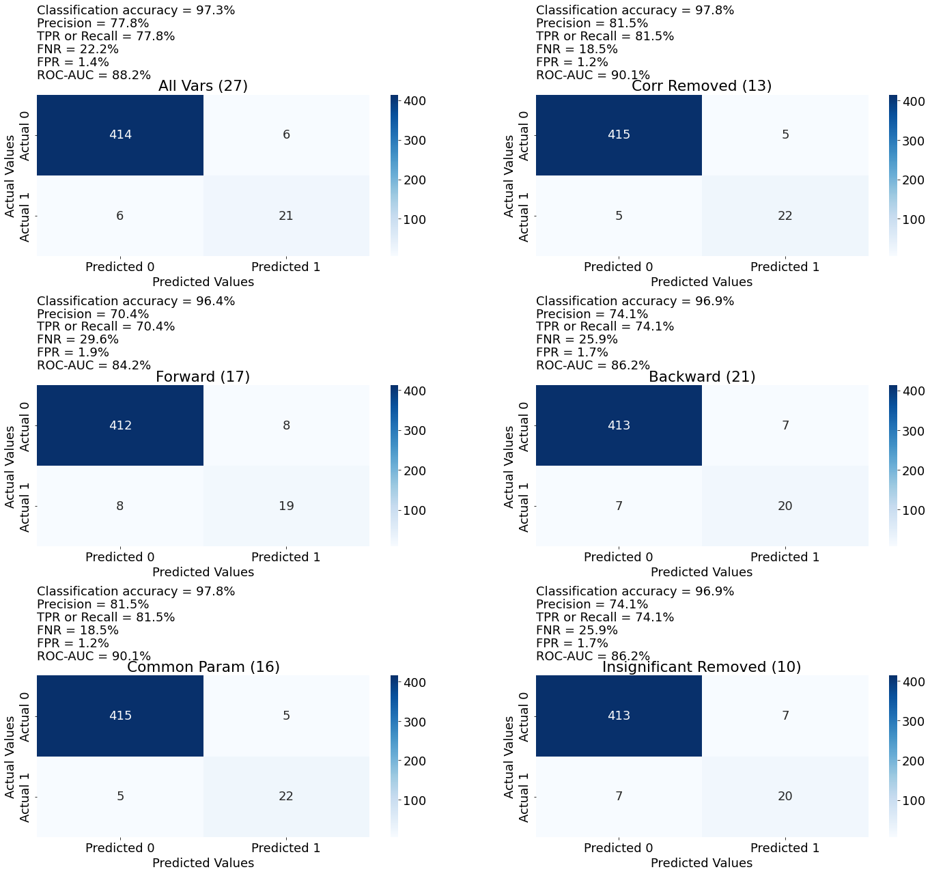
Model Testing
One set of heatmap for 2023 data
All models have 95% + Accuracy
5 sets of analysis done for all 5 test sets.
Characteristic
Same Precision == Recall
Why?
Difficult to compare Models

Slide 16
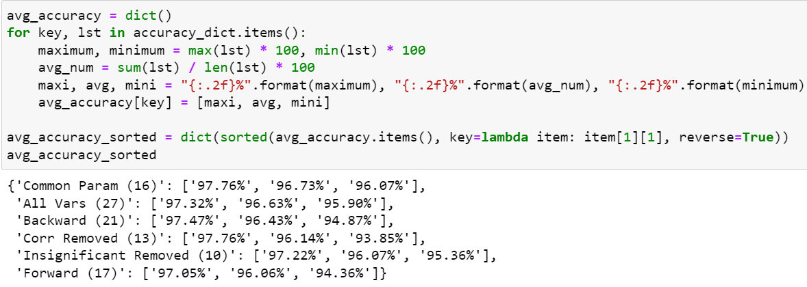
Best Model?
Max Accuracy, Avg Accuracy, Min Accuracy
Average Accuracy Calculated for each model
Common Param has best value for all (max / avg / min) accuracy
Used 4th most # of variables; had best result -> Best Model

Slide 17
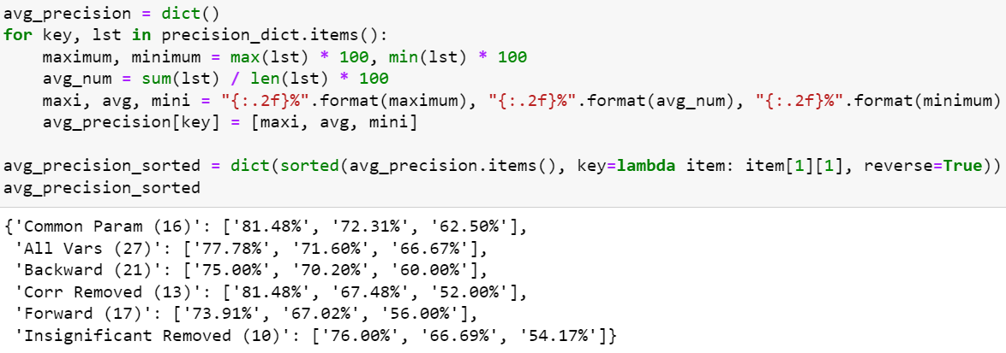
Best Model?
Max Precision, Avg Precision, Min Precision
Average Precision Calculated for each model
Common Param has best value for (max / avg) precision

Slide 18
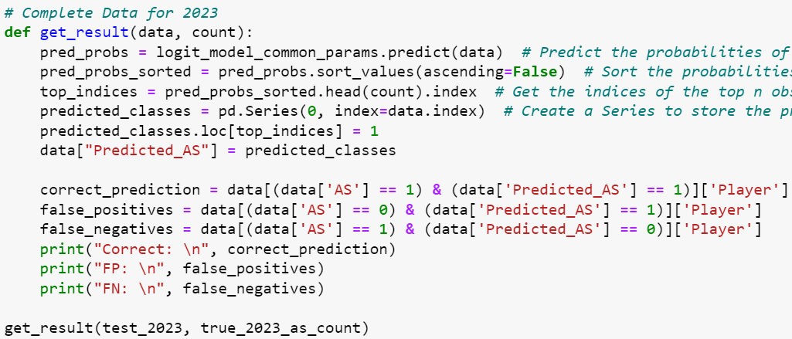
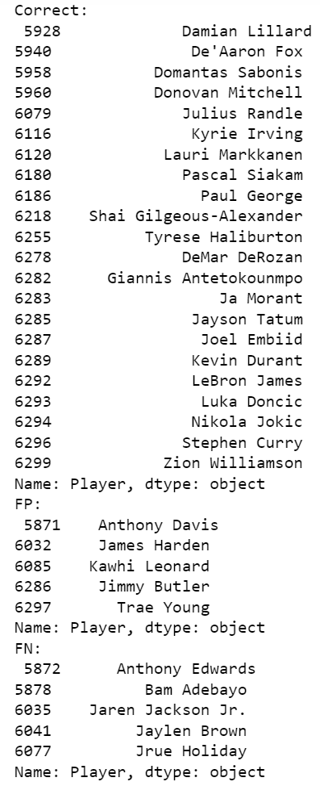
Result on 2023 Data
Players who did not make All Star; Our model predicted them to be
Anthony Davis
James Harden
Kawhi Leonard
Jimmy Butler
Trae Young
Players made All Star; Our model predicted them not to be
Anthony Edwards
Bam Adebayo
Jaren Jackson Jr.
Jaylen Brown
Jrue Holiday

Slide 19
Conclusion
Common Predictor Model Performed the best
Average Accuracy ≈ 97% (Correctly classifying 436 / 450 NBA Players)
Average Precision ≈ 72% (Correctly predicting 18 / 25 NBA All Stars)
2023 All Stars (Using Common Predictor Model)
Accuracy ≈ 97.76% (Correctly classified 437 / 447 NBA Players)
Precision ≈ 81.48% (Correctly predicted 22 / 27 NBA All Stars)
Who beat the Model and made All-Star
Anthony Edwards (Injury Replacement, Reserve)
Bam Adebayo (Reserve)
Jaren Jackson Jr. (Reserve)
Jaylen Brown (Reserve)
Jrue Holiday (Reserve)

Slide 20
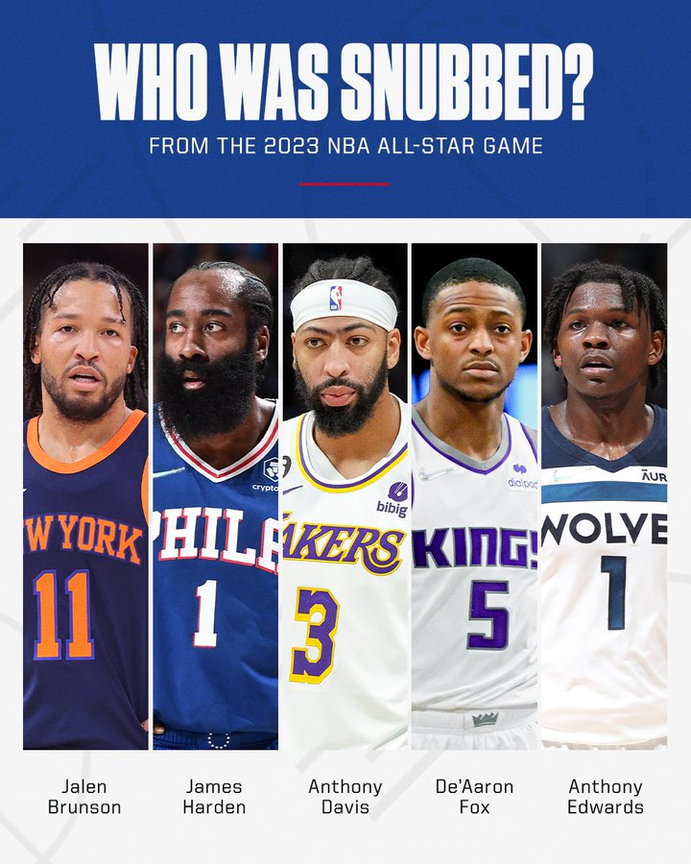
Next Steps…
Traditional statistics don’t tell the whole story:
Advanced statistics may give a better picture of a player’s impact
Number of games played is also a factor fans, journalists and coaches take into account
Besides the player’s performance, team popularity may also play a role in All-Star selection due to fan-votes

